Slide 1


Soil microbial community analysis
Edisa Garcia & Xiu Jia 20 Jan. 2017

Slide 2
Aim
Integrate different softwares to optimize the pipeline from raw 16S rDNA sequences to a OTU table.
OTUs: Operational Taxonomic Units (~species)

Slide 3



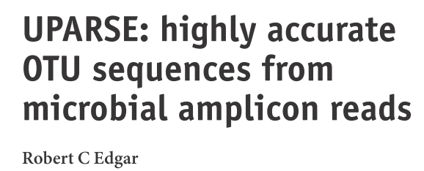
Robust plataform based on PyCogent toolkit that allows rapidly insights about microbial communities
Highly modular → Multiple options in quality filtering
Fast and accurate in merging pair
end-reads
Accurate in chimera detection and OTU generation

Slide 4





Workflow
Obtain 16S rRNA sequencing data
Merge paired-end reads
Quality filtering of fastq reads
Remove chimera sequences
Pick\calculate OTU
Change the data format
Taxonomy annotation
Generate OTU table
Make a Phylogenic tree
alpha, beta diversity analysis
Results visualization

